Slide 1
Advance Java
Lecture 3

Slide 2
Agenda
Introduction to JSP
JSP Architecture
JSP Directives
JSP scripting elements
Default objects in JSP

Slide 3
Introduction to JSP
JavaServer Pages (JSP) is another Java technology for developing web applications.
JSP was released during the time servlet technology had gained popularity as one of the best web technologies available. JSP is not meant to replace servlets, however.
In fact, JSP is an extension of the servlet technology, and it is common practice to use both servlets and JSP pages in the same web applications.
JavaServer Pages (JSP) technology enables you to mix regular, static HTML with dynamically generated content from servlets.
You simply write the regular HTML in the normal manner, using familiar Web-page-building tools.
You then enclose the code for the dynamic parts in special tags, most of which start with <% and end with %>.

Slide 4
Introduction to JSP
JSP uses the same techniques as those found in servlet programming.
For example, in JSP you work with HTTP requests and HTTP responses, request parameters, request attributes, session management, cookies, URL-rewriting, and so on.
What are issues faced with servlets?
Servlet programmers know how cumbersome it is to program with servlets, however, especially when you have to send a long HTML page that includes little code.

Slide 5
Servlet displaying all parameters
public void doPost(HttpServletRequest request,
HttpServletResponse response) throws ServletException, IOException {
response.setContentType("text/html");
PrintWriter out = response.getWriter();
out.println("<HTML>");
out.println("<HEAD><TITLE>Using Servlets</TITLE></HEAD>");
out.println("<BODY BGCOLOR=#123123>");
//Get parameter names
Enumeration parameters = request.getParameterNames();
String param = null;
while (parameters.hasMoreElements()) {
param = (String) parameters.nextElement();
out.println(param + ":" + request.getParameter(param) +
"<BR>");
}
out.println("</BODY>");
out.println("</HTML>");
out.close();
} //End of doPost method

Slide 6
Servlet Issues
Nearly half of the content sent from the doPost method is static HTML. However, each HTML tag must be embedded in a String and sent using the println method of the PrintWriter object.
It is a tedious chore. Worse still, the HTML page may be much longer.
Another disadvantage of using servlets is that every single change will require the intervention of the servlet programmer.
Even a slight graphical modification, such as changing the value of the <BODY> tag's BGCOLOR attribute from #DADADA to #FFFFFF, will need to be done by the programmer.
Sun understood this problem and soon developed a solution. The result was JSP technology.
According to Sun's web site, "JSP technology is an extension of the servlet technology created to support authoring of HTML and XML pages." Combining fixed or static template data with dynamic content is easier with JSP.

Slide 7
Introduction to JSP
What needs to be highlighted is that "JSP technology is an extension of the servlet technology."
This means that JSP did not replace servlets as the technology for writing server-side Internet/intranet applications.
In fact, JSP was built on the servlet foundation and needs the servlet technology to work.
JSP solves drawbacks in the servlet technology by allowing the programmer to intersperse code with static content, for example. If the programmer has to work with an HTML page template written by a web designer, the programmer can simply add code into the HTML page and save it as a .jsp file.
If at a later stage the web designer needs to change the HTML body background color, he or she can do it without wasting the charging-by-the-hour programmer's time. He or she can just open the .jsp file and edit it accordingly.

Slide 8
JSP displaying all parameters
<%@ page import="java.util.Enumeration" %>
<HTML>
<HEAD><TITLE>Using JSP</TITLE></HEAD>
<BODY BGCOLOR=#DADADA>
<%
//Get parameter names
Enumeration parameters = request.getParameterNames();
String param = null;
while (parameters.hasMoreElements()) {
param = (String) parameters.nextElement();
out.println(param + ":" + request.getParameter(param) +
"<BR>");
}
out.close();
%>
</BODY>
</HTML>

Slide 9
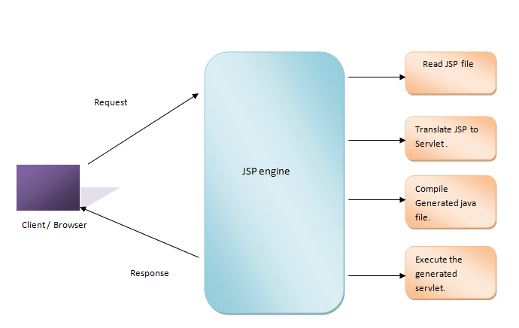
JSP Architecture

Slide 10
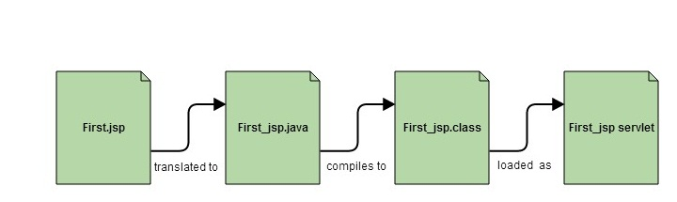
JSP Architecture

Slide 11
JSP Architecture
A typical request / response phase of a JSP is defined below
a) Request is initiated for a jsp file by client using browser
b) Webs server (JSP engine) loads the JSP file and translate the JSP file generate a java code . Generated Java code will be a Servlet.
c) Once Servlet (Java code ) is generated, JSP engine compiles the servlet. Any compilation errors will be detected in this phase.
d) Now servlet class is loaded by the container and executes it.
e) Engine sends the response back to client.
Translation and compilation phase is done only when
a) first request came for the jsp file
b) the generated servlet is older than the JSP file. This is the case when JSP file is modified

Slide 12
Why JSP is preferred over servlets?
JSP provides an easier way to code dynamic web pages.
JSP does not require additional files like, java class files, web.xml etc
Any change in the JSP code is handled by Web Container(Application server like tomcat), and doesn't require re-compilation.
JSP pages can be directly accessed, and web.xml mapping is not required like in servlets.
Advantage of JSP
Easy to maintain and code.
High Performance and Scalability.
JSP is built on Java technology, so it is platform independent.

Slide 13
JSP Directives
JSP directive affects the overall structure of the servlet that results from the JSP page.
The following templates show the two possible forms for directives.
Single quotes can be substituted for the double quotes around the attribute values, but the quotation marks cannot be omitted altogether.
To obtain quote marks within an attribute value, precede them with a back slash, using \’ for ’ and \" for ".
<%@ directive attribute="value" %>
<%@ directive attribute1="value1"
attribute2="value2"
...
attributeN="valueN" %>

Slide 14
JSP Directives
Directives are messages to the JSP container containing information on how the JSP container must translate a JSP page into a corresponding servlet.
Directives have the following syntax:
<%@ directive (attribute="value")* %>
White spaces after the opening <%@ and before the closing %> are optional, but are recommended to enhance readability.

Slide 15
JSP Directives
In JSP, there are three types of directives: page, include, and taglib.
The page directive lets you control the structure of the servlet by importing classes, customizing the servlet superclass, setting the content type, and the like. A page directive can be placed anywhere within the document.
The second directive, include, lets you insert a file into the servlet class at the time the JSP file is translated into a servlet. An include directive should be placed in the document at the point at which you want the file to be inserted.
JSP 1.1 introduces a third directive, taglib, which can be used to define custom markup tags.

Slide 16
Page Directive
The Page directive has the following syntax:
<%@ page (attribute="value")* %>

Slide 17
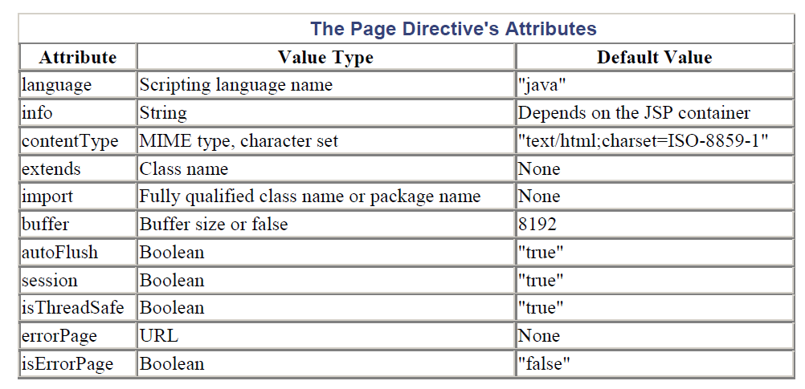

Slide 18
Page Directive
An example of the use of the Page directive is as follows:
<%@ page buffer="16384" session="false" %>
With JSP, you can specify multiple page directives in your JSP page, such as the following:
<%@ page buffer="16384" %>
<%@ page session="false" %>
Except for the import attribute, however, JSP does not allow you to repeat the same attribute within a page directive or in multiple directives on the same page.
The following is illegal because the info attribute appears more than once in a single page:
<%@ page info="Example Page" %>
<%@ page buffer="16384" %>
<%@ page info="Unrestricted Access" %>

Slide 19
Page Directive
The following also is illegal because the buffer attribute appears more than once in the same page directive:
<%@ page buffer="16384" info="Example Page" buffer="8192" %>
The following is legal, however, because the import attribute can appear multiple times:
<%@ page import="java.io.*" info="Example Page" %>
<%@ page import="java.util.Enumeration" %>
<%@ page import="com.brainysoftware.web.FileUpload" %>
Alternatively, imported libraries can appear in a single import attribute, separated by commas, as shown in the following code:
<%@ page import="java.io.*, java.util.Enumeration" %>

Slide 20
Include Directive
This directive enables JSP page authors to include the contents of other files in the current JSP page.
The include directive is useful if you have a common source that will be used by more than one JSP page. Instead of repeating the same code in every JSP page, thus creating a maintenance problem, you can place the common code in a separate file and use an include directive from each JSP page.
The included page itself can be static, such as an HTML file, or dynamic, such as another JSP page.
If you are including a JSP page, the included JSP page itself can include another file.
Therefore, nesting include directives is permitted in JSP.
The syntax for the include directive is as follows:
<%@ include file="relativeURL" %>

Slide 21
Include Directive
The following is an example of how to include HTML files:
<%@ include file="includes/header.html" %>
<%
out.println("<BODY>");
// other content;
%>
<%@ include file="includes/footer.html" %>

Slide 22
Taglib Directive
The JSP taglib directive is used to define a tag library that defines many tags. We use the TLD (Tag Library Descriptor) file to define the tags. In the custom tag section we will use this tag so it will be better to learn it in custom tag.
<%@ taglib uri="uriofthetaglibrary" prefix="prefixoftaglibrary" %>
Example
<%@ taglib uri="http://www.tagexp.com/tags" prefix="mytag" %>
The taglib directive declares that your JSP page uses a set of custom tags, identifies the location of the library, and provides means for identifying the custom tags in your JSP page.

Slide 23
Taglib Directive
For example, suppose the custlib tag library contains a tag called hello. If you wanted to use the hello tag with a prefix of mytag, your tag would be <mytag:hello> and it will be used in your JSP file as follows :
<%@ taglib uri = "http://www.example.com/custlib" prefix = "mytag" %>
<html>
<body>
<mytag:hello/>
</body>
</html>

Slide 24
JSP Scripting Elements
Scripting elements allow you to insert Java code in your JSP pages. There are three types of scripting elements:
Scriptlets
Declarations
Expressions

Slide 25
Scriptlets
Scriptlets are the code blocks of a JSP page. Scriptlets start with an opening <% tag and end with a closing %> tag.

Slide 26
Example
<%@ page session="false" %>
<%@ page import="java.sql.*" %>
<%
try {
Class.forName("sun.jdbc.odbc.JdbcOdbcDriver");
System.out.println("JDBC driver loaded");
}
catch (ClassNotFoundException e) {
System.out.println(e.toString());
}
%>
<HTML>
<HEAD>
<TITLE>Display All Users</TITLE>
</HEAD>
<BODY>
<CENTER>
<BR><H2>Displaying All Users</H2>
<BR>
<BR>
<TABLE>
<TR>
<TH>First Name</TH>
<TH>Last Name</TH>
<TH>User Name</TH>
<TH>Password</TH>
</TR>

Slide 27
Example
<%
String sql = "SELECT FirstName, LastName, UserName, Password" +
" FROM Users";
try {
Connection con = DriverManager.getConnection("jdbc:odbc:JavaWeb");
Statement s = con.createStatement();
ResultSet rs = s.executeQuery(sql);
while (rs.next()) {
out.println("<TR>");
out.println("<TD>" + rs.getString(1) + "</TD>");
out.println("<TD>" + rs.getString(2) + "</TD>");
out.println("<TD>" + rs.getString(3) + "</TD>");
out.println("<TD>" + rs.getString(4) + "</TD>");
out.println("</TR>");
}
rs.close();
s.close();
con.close();
}
catch (SQLException e) {
}
catch (Exception e) {
}
%>
</TABLE>
</CENTER>
</BODY>
</HTML>

Slide 28
JSP Page that Interweaves HTML Tags with Scriptlets
<TR>
<TD><% out.print(rs.getString(1)); %></TD>
<TD><% out.print(rs.getString(2)); %></TD>
<TD><% out.print(rs.getString(3)); %></TD>
<TD><% out.print(rs.getString(4)); %></TD>
</TR>

Slide 29
Declarations
Declarations allow you to declare methods and variables that can be used from any point in the JSP page.
Declarations also provide a way to create initialization and clean-up code by utilizing the jspInit and jspDestroy methods.
A declaration starts with a <%! and ends with a %> and can appear anywhere throughout the page.
For example, a method declaration can appear above a page directive that imports a class, even though the class is used in the method.

Slide 30
Example
<%!
String getSystemTime() {
return Calendar.getInstance().getTime().toString();
}
%>
<%@ page import="java.util.Calendar" %>
<%@ page session="false" %>
<%
out.println("Current Time: " + getSystemTime());
%>
<%! int i; %>

Slide 31
JSP Page with a Method Declaration
<%!
String encodeHtmlTag(String tag) {
if (tag == null)
return null;
int length = tag.length();
StringBuffer encodedTag = new StringBuffer(2 * length);
for (int i=0; i<length; i++) {
char c = tag.charAt(i);
if (c == '<')
encodedTag.append("<");
else if (c == '>')
encodedTag.append(">");
else if (c == '&')
encodedTag.append("&amp;");
else if (c == '"')
encodedTag.append("&quot;");
//when trying to output text as tag's value as in
// values="???".
else if (c == ' ')
encodedTag.append("&nbsp;");
else
encodedTag.append(c);
}
return encodedTag.toString();
}
%>
<%@ page session="false" %>
<%@ page import="java.sql.*" %>

Slide 32
Expressions
Expressions are the last type of JSP scripting elements.
Expressions get evaluated when the JSP page is requested and their results are converted into a String and fed to the print method of the out implicit object.
If the result cannot be converted into a String, an error will be raised at translation time.
If this is not detected at translation time, at request-processing time, a ClassCastException will be raised.
An expression starts with a <%= and ends with a %>. You don't add a semicolon at the end of an expression.

Slide 33
Expressions
Current Time: <%= java.util.Calendar.getInstance().getTime() %>
This expression will be translated into the following statement in the _jspService method of the generated servlet:
out.print( java.util.Calendar.getInstance().getTime() );
The expression is equivalent to the following scriptlet:
Current Time: <% out.print(java.util.Calendar.getInstance().getTime()); %>
while (rs.next()) {
%>
<TR>
<TD><%= encodeHtmlTag(rs.getString(1)) %></TD>
<TD><%= encodeHtmlTag(rs.getString(2)) %></TD>
<TD><%= encodeHtmlTag(rs.getString(3)) %></TD>
<TD><%= encodeHtmlTag(rs.getString(4)) %></TD>
</TR>

Slide 34
Default Objects in JSP
JSP implicit objects are created during the translation phase of JSP to the servlet.
These objects can be directly used in scriplets that goes in the service method.
They are created by the container automatically, and they can be accessed using objects.
There are 9 types of implicit objects available in the container:
out
request
response
config
application
session
pageContext
page
exception

Slide 35
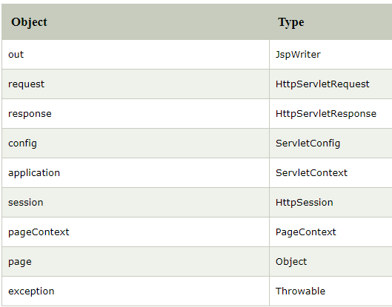
Default Objects in JSP

Slide 36
Default Objects in JSP
out
Out is one of the implicit objects to write the data to the buffer and send output to the client in response
Out object allows us to access the servlet's output stream
Out is object of javax.servlet.jsp.jspWriter class
While working with servlet, we need printwriter object
Request
The request object is an instance of java.servlet.http.HttpServletRequest and it is one of the argument of service method
It will be created by container for every request.
It will be used to request the information like parameter, header information , server name, etc.
It uses getParameter() to access the request parameter.

Slide 37
Default Objects in JSP
Response
"Response" is an instance of class which implements HttpServletResponse interface
Container generates this object and passes to _jspservice() method as parameter
"Response object" will be created by the container for each request.
It represents the response that can be given to the client
The response implicit object is used to content type, add cookie and redirect to response page
Config
"Config" is of the type java.servlet.servletConfig
It is created by the container for each jsp page
It is used to get the initialization parameter in web.xml

Slide 38
Default Objects in JSP
Application
Application object is an instance of javax.servlet.ServletContext and it is used to get the context information and attributes in JSP.
Application object is created by container one per application, when the application gets deployed.
Servletcontext object contains a set of methods which are used to interact with the servlet container.We can find information about the servlet container.
Session
The session is holding "httpsession" object.
Session object is used to get, set and remove attributes to session scope and also used to get session information

Slide 39
Default Objects in JSP
pageContext:
This object is of the type of pagecontext.
It is used to get, set and remove the attributes from a particular scope.
Scopes are of 4 types:
Page
Request
Session
Application
In the example given ahead we are setting the attribute using pageContext object, and it has three parameters:
Key
Value
Scope

Slide 40
Default Objects in JSP
<%@ page language="java" contentType="text/html; charset=ISO-8859-1"
pageEncoding="ISO-8859-1"%>
<!DOCTYPE html PUBLIC "-//W3C//DTD HTML 4.01 Transitional//EN" "http://www.w3.org/TR/html4/loose.dtd">
<html>
<head>
<meta http-equiv="Content-Type" content="text/html; charset=ISO-8859-1">
<title>Implicit JSP9</title>
</head>
<body>
<% pageContext.setAttribute("student","student_name",pageContext.PAGE_SCOPE);
String name = (String)pageContext.getAttribute("student");
out.println("student name is " +name);
%>
</body>
</html>

Slide 41
Default Objects in JSP
Page implicit variable holds the currently executed servlet object for the corresponding jsp.
Acts as this object for current jsp page.
In this example given ahead, we are using page object to get the page name using toString method

Slide 42
Default Objects in JSP
<%@ page language="java" contentType="text/html; charset=ISO-8859-1"
pageEncoding="ISO-8859-1"%>
<!DOCTYPE html PUBLIC "-//W3C//DTD HTML 4.01 Transitional//EN" "http://www.w3.org/TR/html4/loose.dtd">
<html>
<head>
<meta http-equiv="Content-Type" content="text/html; charset=ISO-8859-1">
<title>Implicit JSP10</title>
</head>
<body>
<% String pageName = page.toString();
out.println("Page Name is " +pageName);%>
</body>
</html>

Slide 43
Default Objects in JSP
Exception
Exception is the implicit object of the throwable class.
It is used for exception handling in JSP.
The exception object can be only used in error pages.

Slide 44
Default Objects in JSP
<%@ page language="java" contentType="text/html; charset=ISO-8859-1"
pageEncoding="ISO-8859-1" isErrorPage="true"%>
<!DOCTYPE html PUBLIC "-//W3C//DTD HTML 4.01 Transitional//EN" "http://www.w3.org/TR/html4/loose.dtd">
<html>
<head>
<meta http-equiv="Content-Type" content="text/html; charset=ISO-8859-1">
<title>Implicit Guru JSP</title>
</head>
<body>
<%int[] num1={1,2,3,4};
out.println(num1[5]);%>
<%= exception %>
</body>
</html>

Slide 45
Default Objects in JSP
It has an array of numbers, i.e., num1 with four elements. In the output, we are trying to print the fifth element of the array from num1, which is not declared in the array list. So it is used to get exception object of the jsp.
We are getting ArrayIndexOfBoundsException in the array where we are getting a num1 array of the fifth element.

Slide 46
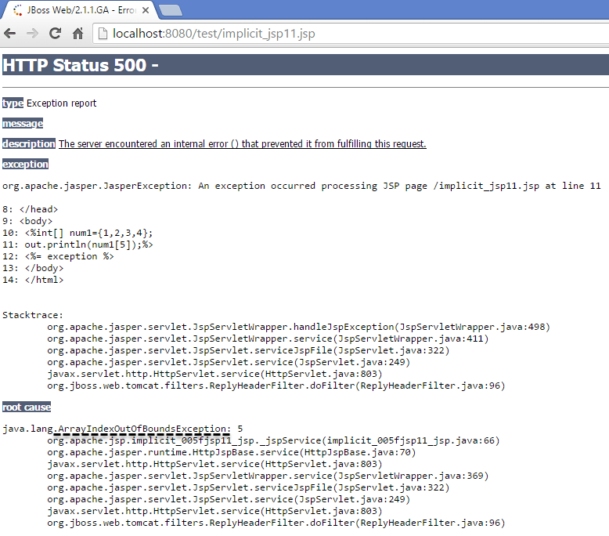

Slide 47
Thank You

